Slide 1
Software Design and Analysis
State chart diagrams
Notes:
7,8,10 march
10 march procom so class was on 3/3

Slide 2
Today’s Outline
State chart Diagrams
Elements of State chart Diagrams
Notations of State chart Diagrams
Why State chart Diagrams?
States
Composite States
Concurrent States
Transitions
Events

Slide 3
i. Static
a. Use case diagram
b. Class diagram
ii. Dynamic
a. Activity diagram
b. Sequence diagram
c. Object diagram
d. State diagram
e. Collaboration diagram
iii. Implementation
a. Component diagram
b. Deployment diagram

Slide 4
State Chart Diagrams
A state machine diagram models the behavior of a single object, specifying the sequence of events that an object goes through during its lifetime in response to events.
A state chart diagram is normally used to model how the state of an object changes in its lifetime.
State chart diagrams are good at describing how the behavior of an object changes across several use case executions. However, if we are interested in modeling some behavior that involves several objects collaborating with each other, state chart diagram is not appropriate.
Notes:
A state diagram or state chart specifies a state machine.
A state machine is described for a class.
Each object has it’s own state machine

Slide 5
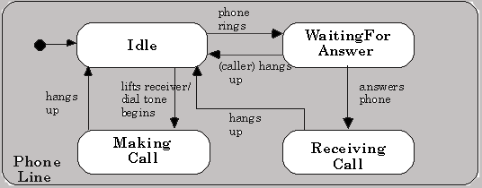
State Chart Diagram – Phone Line

Slide 6
Why Use State chart Diagrams?
State charts typically are used to describe state-dependent behavior for an object
An object responds differently to the same event depending on what state it is in.
Usually applied to objects but can be applied to any element that has behavior
Actors, use cases, methods, subsystems, systems
Statecharts are typically used in conjunction with interaction diagrams (usually sequence diagrams)
A statechart describes all events (and states and transitions for a single object)
A sequence diagram describes the events for a single interaction across all objects involved

Slide 7
State Chart Diagrams
State diagrams describe the life of an object using three main elements:
States of an object
Transitions between states
Events that trigger the transitions

Slide 8


States
State is a condition or situation during the life of an object within which it performs some activity, or waits for some events .
State may also label activities, e.g., do/check item
Examples of object states are:
The invoice (object) is paid (state).
The car (object) is standing still (state).
The engine (object) is running (state).
Jim (object) is playing the role of a salesman (state).
Notes:
States in state chart diagrams represent a set of those value combinations, in which an object behaves the same in response to events.
Therefore, not every modification of an attribute leads to a new state.

Slide 9
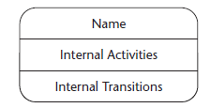
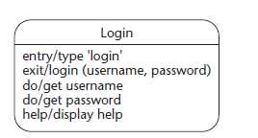
State Compartments
The third compartment is the optional internal transition compartment. This compartment contains a list of internal transitions. A transition can be listed more than once if it has different guard conditions.

Slide 10


Initial/Final States
Initial State
A filled circle followed by an arrow represents the object's initial state.
Final State
An arrow pointing to a filled circle nested inside another circle represents the object's final state.

Slide 11

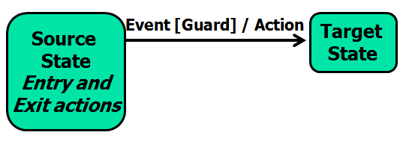
Transition
Show what the dependencies are between the state of an object and its reactions to messages or other events
A solid arrow represents the path between different states of an object.
Label the transition with the event that triggered it and the action that results from it.
A state can have a transition that points back to itself.

Slide 12
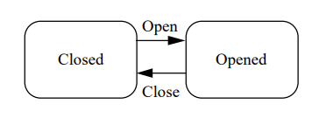
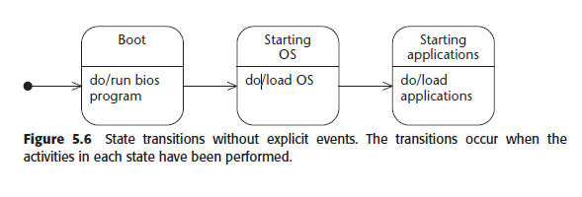
Examples
If a Bank Account was Closed and it saw an Open event, it would end up in the Opened state - If the account was Opened and it saw a Close event it would end up in the Closed state.
Notes:
Item Received is an event, /get first item is an action, [Not all items checked] is a guard

Slide 13
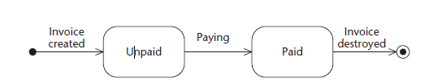
Events
An object transitions (changes) from one state to another state when something happens, which is called an event; for example, someone pays an invoice, starts driving the car,
An event is an instant in time that may be significant to the behavior of the objects in a class - Events can have associated arguments
Events are written simply as text strings
Open
Deposit(Amount)
Withdraw(Amount)
Close

Slide 14
Types of Events
A condition becoming true. This is shown as a guard-condition on a state transition.
Passage of a designated period of time.

Slide 15
Guard Condition
Guard-condition is a Boolean expression placed on a state transition. If the guard-condition is combined with an event-signature, the event must occur, and the guard-condition must be true for the transition to fire.
If only a guardcondition is attached to a state transition, the transition fires when the condition becomes true Examples of state transitions with a guard-condition are as follows:
[t = 15sec]
[number of invoices > n]
withdrawal (amount) [balance >= amount]

Slide 16
Internal transitions
An event causes only some internal actions to execute but does not lead to a change of state (state transition). In this case, all actions executed comprise the internal transition.
For example, when one types on a keyboard, it responds by generating different character codes. However, unless the Caps Lock key is pressed, the state of the keyboard does not change (no state transition occurs).

Slide 17
Composite State
A state can be refined hierarchically by composite states.
Generally, composite state is defined as state that has substates (nested states). Substates could be sequential (disjoint) or concurrent (orthogonal).
A state allows nesting to contain substates. A substate inherits the transitions of its superstate (the enclosing state).
Within the Active state, and no matter what substate the object is in, if the on hook event occurs, a transition to the idle state occurs.

Slide 18
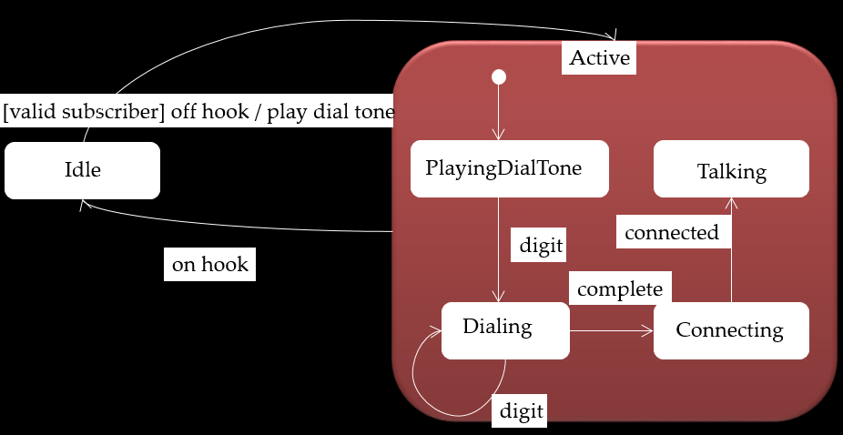
Composite States/Nested State

Slide 19
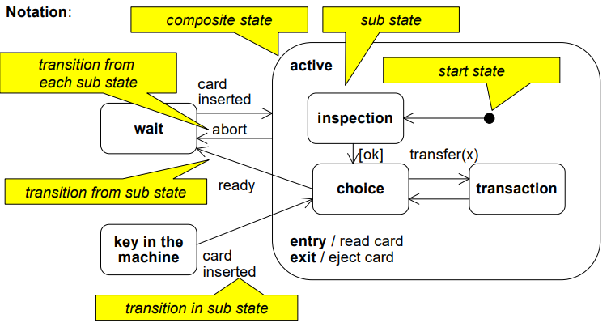
Composite State
A state can be refined hierarchically by composite states.

Slide 20
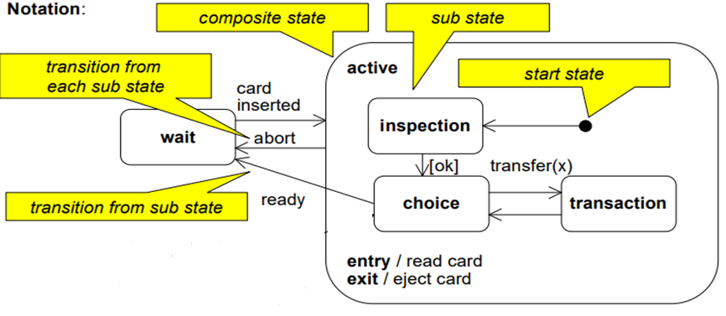
Composite State

Slide 21
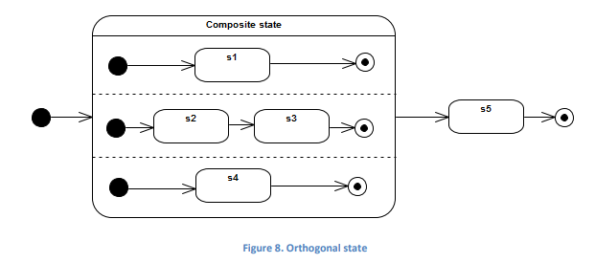
Concurrency
Concurrency on a state machine diagram can be expressed by an orthogonal state (a composite state with multiple regions).
If an entering transition terminates on the edge of the orthogonal state, then all of its regions are entered.
When exiting from an orthogonal state, each of its regions is exited

Slide 22
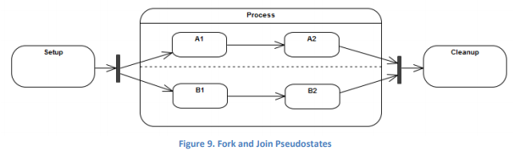
Concurrency
Concurrency can be shown explicitly using fork and join pseudostates.
A fork is represented by a bar with one or more outgoing arrows terminating on orthogonal regions (i.e. states in different regions);
A join merges one or more transitions.
Concurrent substates specify two or more state machines that execute in parallel in the context of the enclosing object
Execution of these concurrent substates continues in parallel. These substates waits for each other to finish to joins back into one flow
Notes:
In UML modeling, a pseudostate is used to combine and direct transitions.

Slide 23
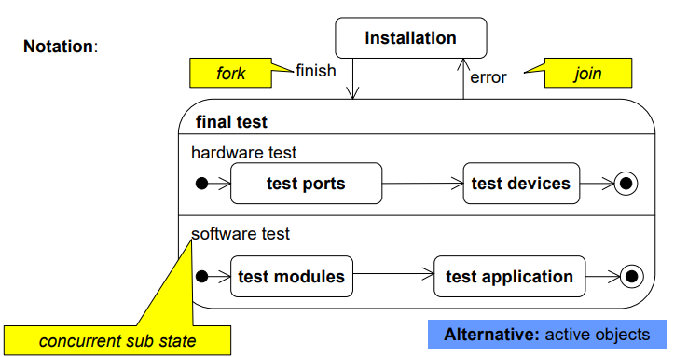
Concurrent Sub States
In a state several sequences of sub states described by own state machines can be performed concurrently.

Slide 24
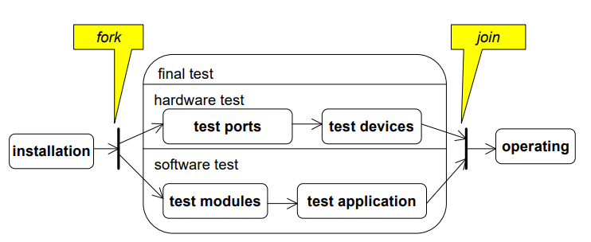
Concurrent Sub States: Alternative

Slide 25
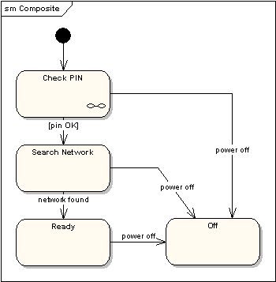
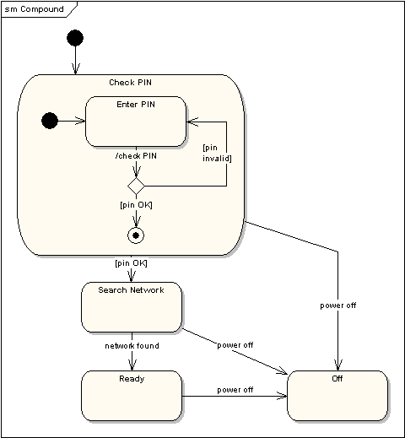
State Machine Diagrams
Compound States - A state machine diagram may include sub-machine diagrams, as in the example below.
Alternative way to show the same information
The ∞ symbol indicates that details of the Check PIN
sub-machine are shown in a separate diagram.
Notes:
Decomposition state

Slide 26
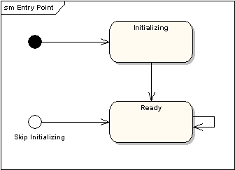
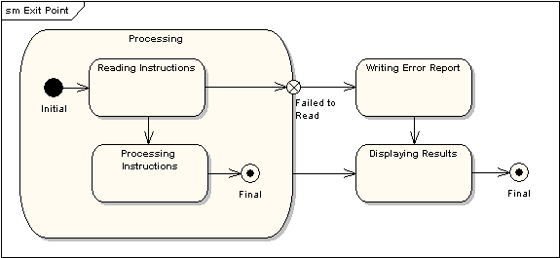
State Machine Diagrams
Entry Point - Sometimes you won’t want to enter a sub-machine at the normal initial state. For example, in the following sub-machine it would be normal to begin in the "Initializing" state, but if for some reason it wasn’t necessary to perform the initialization, it would be possible to begin in the "Ready" state by transitioning to the named entry point.
Exit Point - In a similar manner to entry points, it is possible to have named alternative exit points. The following diagram gives an example where the state executed after the main processing state depends on which route is used to transition out of the state.

Slide 27
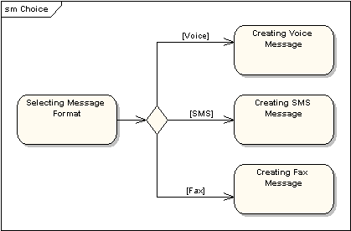
State Machine Diagrams
Choice Pseudo-State - A choice pseudo-state is shown as a diamond with one transition arriving and two or more transitions leaving. The following diagram shows that whichever state is arrived at, after the choice pseudo-state, is dependent on the message format selected during execution of the previous state.

Slide 28
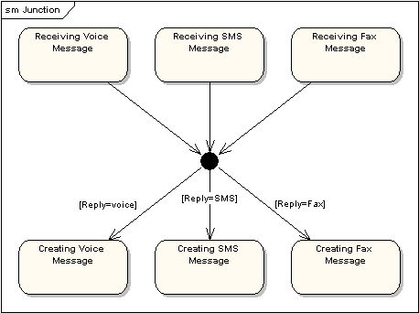
State Machine Diagrams
Junction Pseudo-State - Junction pseudo-states are used to chain together multiple transitions. A single junction can have one or more incoming, and one or more outgoing, transitions; a guard can be applied to each transition. Junctions are semantic-free.
Notes:
A junction which splits an incoming transition into multiple outgoing transitions realizes a static conditional branch, as opposed to a choice pseudo-state which realizes a dynamic conditional branch.

Slide 29
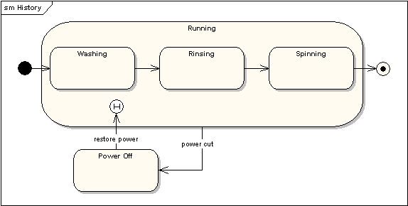
State Machine Diagrams
History States - A history state is used to remember the previous state of a state machine when it was interrupted. The following diagram illustrates the use of history states. The example is a state machine belonging to a washing machine.
Notes:
In this state machine, when a washing machine is running, it will progress from "Washing" through "Rinsing" to "Spinning". If there is a power cut, the washing machine will stop running and will go to the "Power Off" state. Then when the power is restored, the Running state is entered at the "History State" symbol meaning that it should resume where it last left-off.

Slide 30
State Chart Diagrams
Checklist : Statechart Diagrams
 Identify mutation events relevant for the object—
What affects the object?
 Group relevant events chronologically—How does a
normal life look?
 Model states and transitions—Which states are there?
 Add actions to the statechart diagram—What do
objects do?
 Verify the statechart diagram—Is everything correct?

Slide 31
 Internal Transition: transition from one state to
itself. Object handles event without changing its state.
Mutation Event: The initiator of a transition from one state to another, or for an internal transition, where the state remains the same.

Slide 32
Activity diagram vs. State chart diagram
Both activity and state chart diagrams model the dynamic behavior of the system. Activity diagram is essentially a flowchart showing flow of control from activity to activity. A state chart diagram shows a state machine emphasizing the flow of control from state to state.
An activity diagram is a special case of a state chart diagram in which all or most of the states are activity states and all or most of the transitions are triggered by completion of activities in the source state (An activity is an ongoing non-atomic execution within a state machine).
Activity diagrams may stand alone to visualize, specify, and document the dynamics of a society of objects or they may be used to model the flow of control of an operation. State chart diagrams may be attached to classes, use cases, or entire systems in order to visualize, specify, and document the dynamics of an individual object.

Slide 33
Scenario:
A car Rental company wants to develop an automated system that would handle car reservations, customer billing
and car auctions. Usually a customer reserves a car, picks it up and then returns it after a certain period of time.
When the car is returned, the customer receives a bill and pays the specified amount. In addition to renting out
cars, every year, the company auctions the cars which have accumulated over 30,000 kilometers. For a particular
car, there can be many reservations for different time periods and the company may make reservations for a car for
future time periods even while it is picked. There can be situations where a car may not have any reservations at all
and hence, the car would be truly available for reservations or auctioning.
Draw a state diagram showing all the states and transitions of a car object to include the events which cause the
transitions.

Slide 34
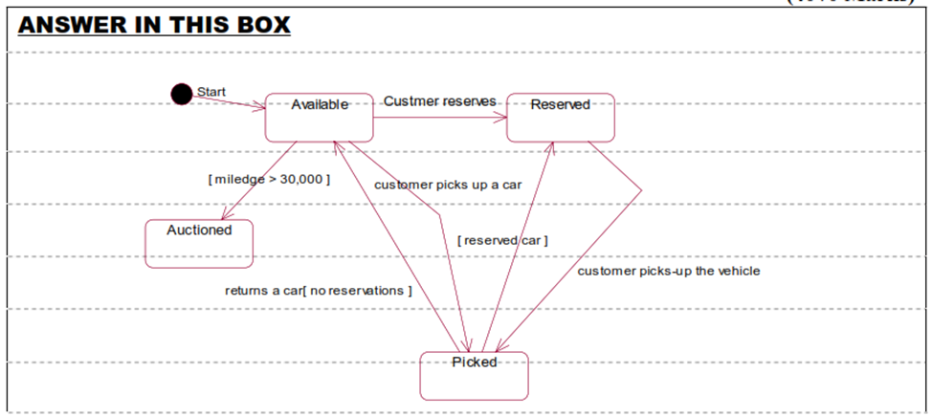

Slide 35

That is all

